Slide 1
Intellitune Mid-Semester Presentation
Automatic Ham Radio Antenna Tuner

Slide 2
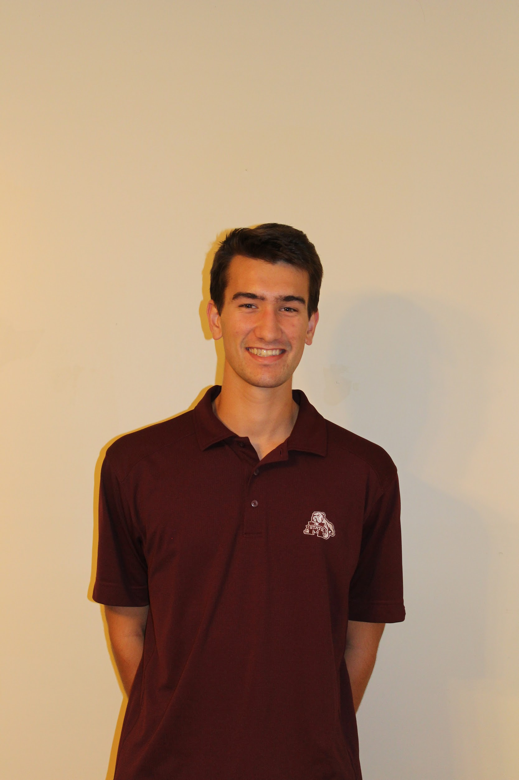

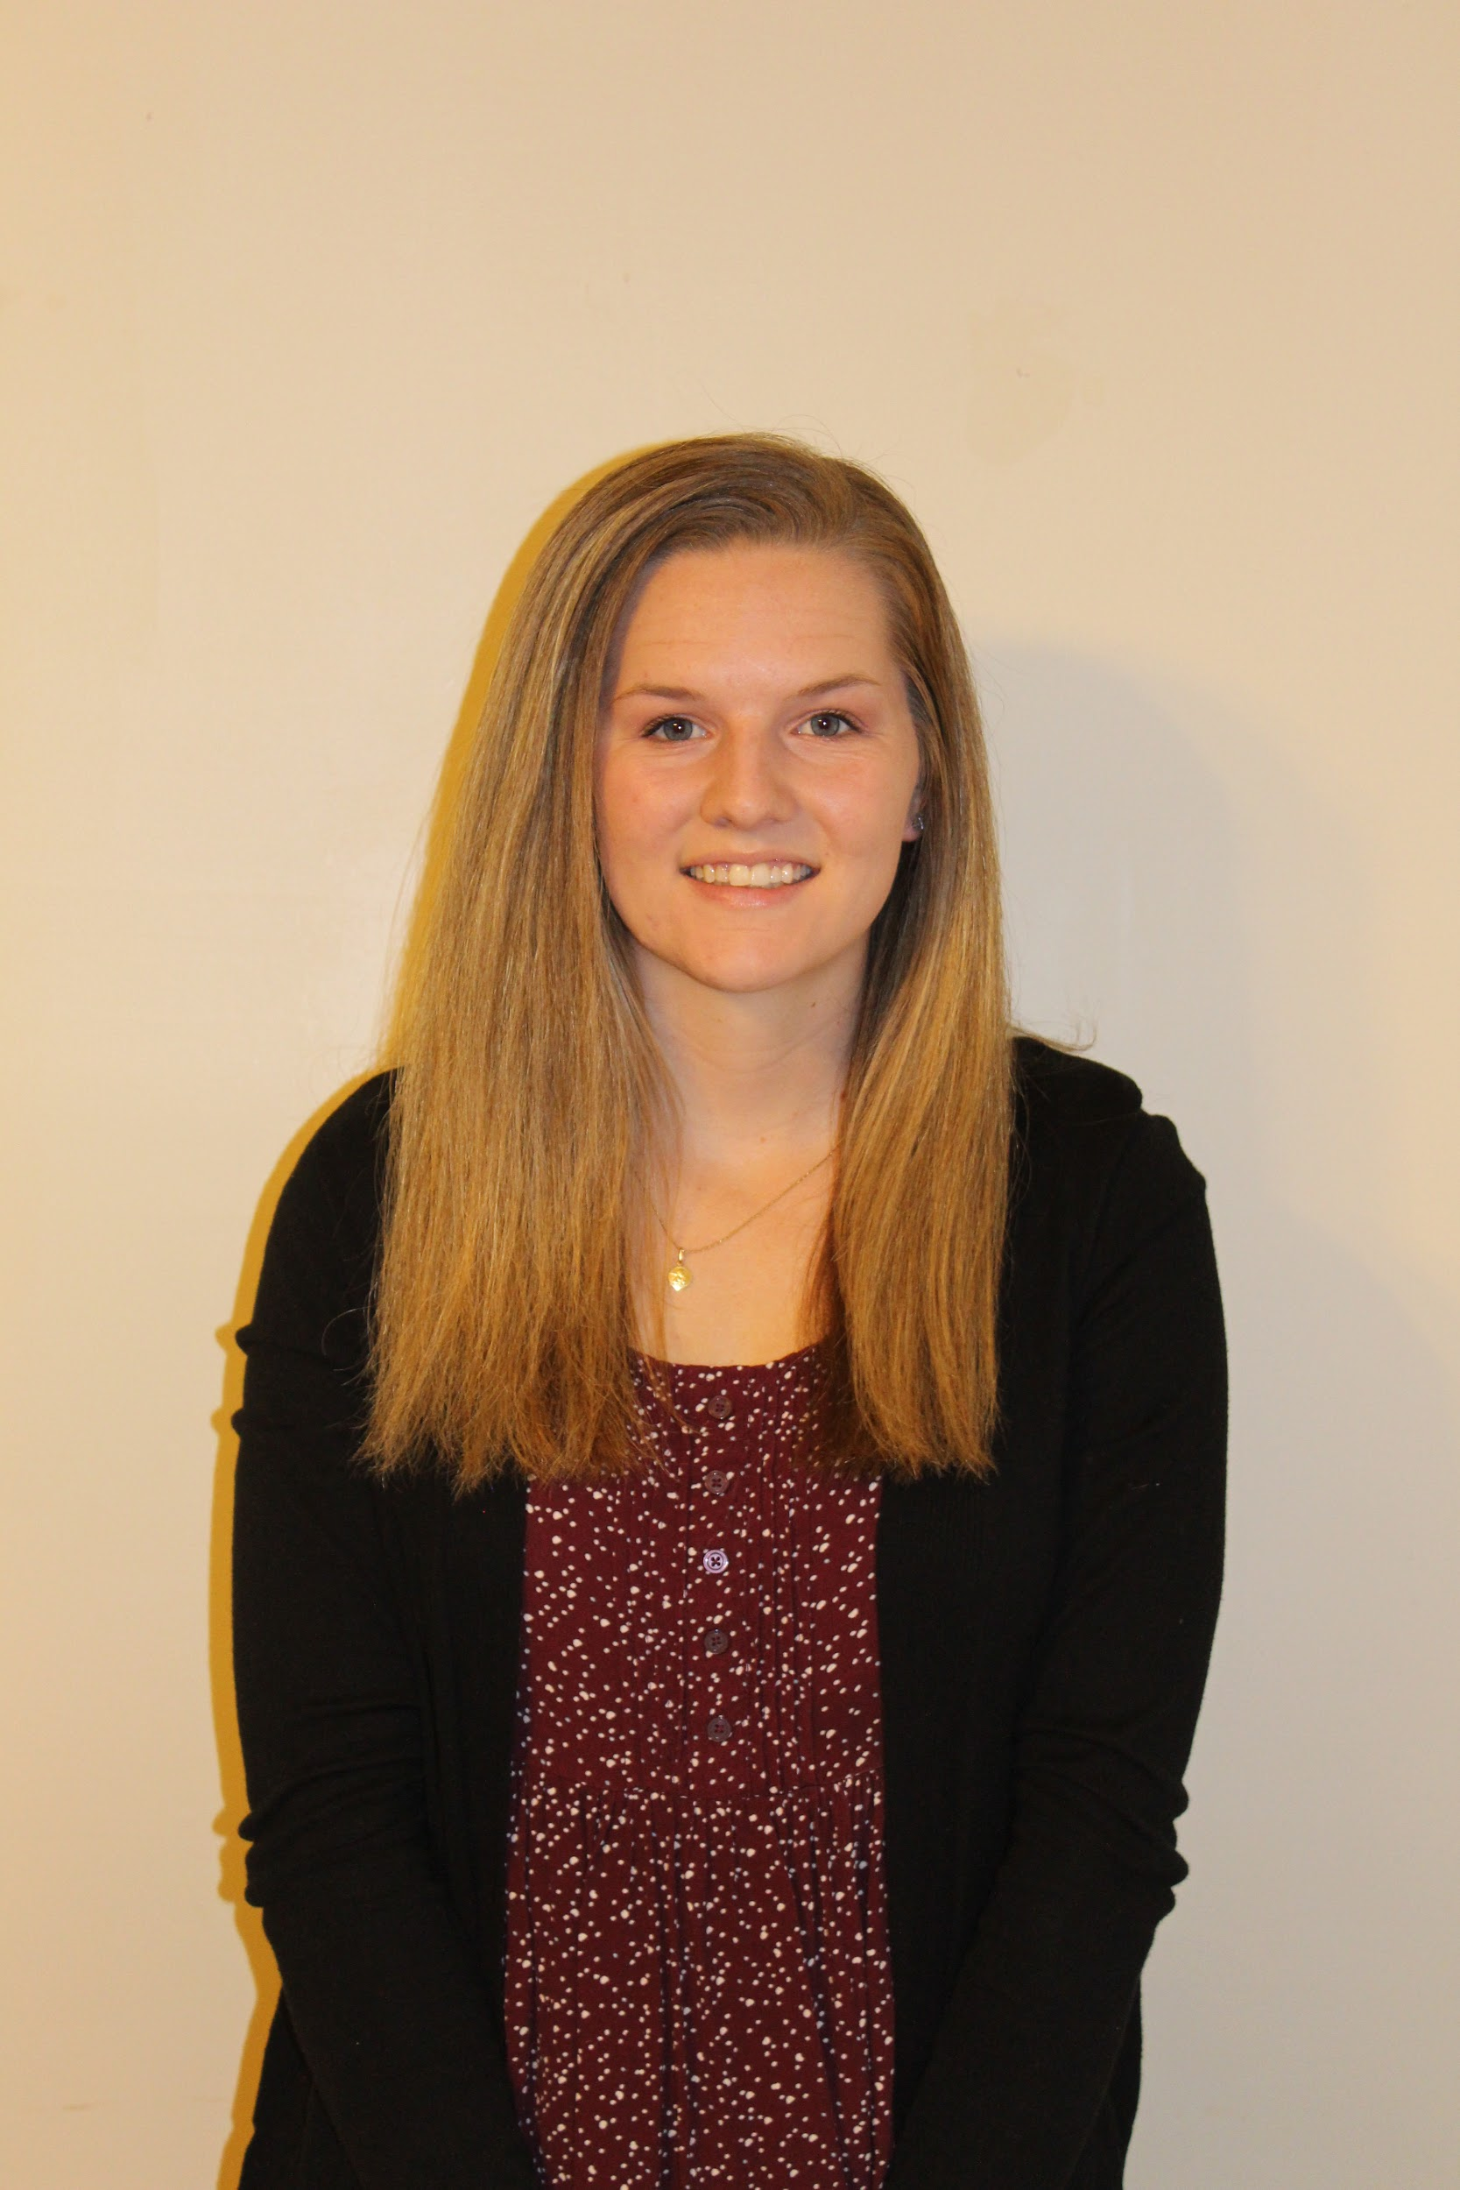

Team Members
Preston Peranich
Jonah Stevens
Haley Knable
Noah Ihediwa
Electrical Engineering
Team Lead
Electrical Engineering
Electrical Engineering
Electrical Engineering

Slide 3

Faculty Advisor
Dr. Mehmet Kurum
Education/Qualification
BS, Electrical and Electronics Engineering, Bogazici University, 2003
MS, Electrical and computer Engineering, George Washington University, 2005
PhD, Electrical and Computer Engineering, George Washington University, 2009
Research and Interest
Microwave and Millimeter-wave Remote Sensing
RF Sensors and Systems
Radiation and Scattering Theory
Antennas and Computational Electromagnetics
Subsurface and Subcanopy Sensing and Imaging
GNSS Reflectometry

Slide 4
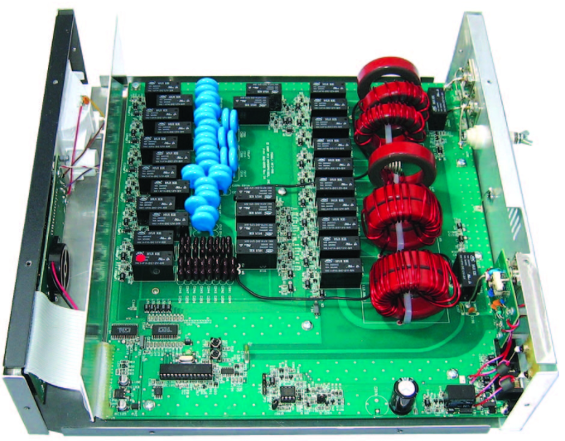
Problem Statement
Amateur Radio Application of Antenna Tuning Unit (ATU)
Manual vs. Automatic Tuning
MFJ-998 Model

Slide 5
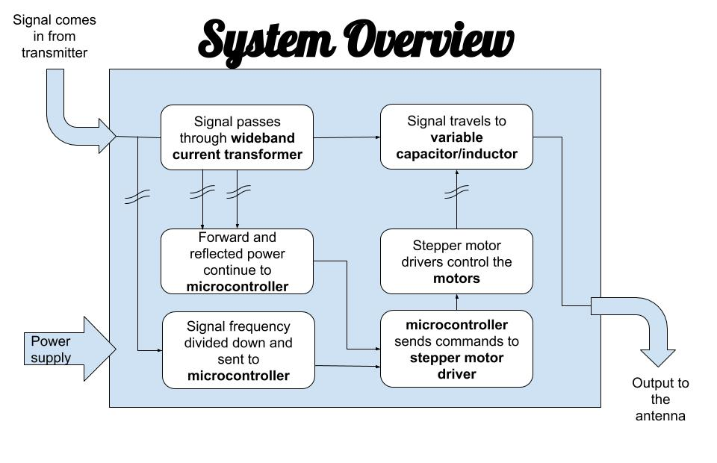
Solution

Slide 6
Technical Constraints
Name | Description
Power Rating | The Intellitune must be capable of handling 1.5 kW of transmitting power.
Bandwidth | Tuning circuitry must pass through frequencies in the 1.5 MHz to 30 MHz band.
VSWR Sensing | The Intellitune must measure the forward and reflected power to determine the voltage standing wave ratio (VSWR) for up to a 32:1 mismatch.
Frequency Sampling | The microcontroller must sample the transmitting signal and determine the frequency up to the maximum 30 MHz limit.
Impedance Matching | The Intellitune must provide a tuning network that is capable of matching antenna impedances from 12-1600 ohms.

Slide 7

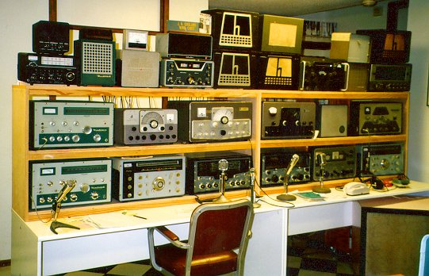
Practical constraints
User Safety
Product Size [1]
Notes:
The two main practical constraints that need to be taken into consideration are user safety, and product size. User safety is critical for a product like intelletune that is capable of handling 1.5 kilowatts. The product must be manufactured with safety in mind so that the front panel , as well as the rest of the enclosure is safe to be touched.
The second constraint that must be kept in mind is the physical size of the enclosure. A ham radio operator typically has a work-bench, or desk, with many different modules that perform different tasks in their set up. The Intellitune must remain competitive be compact enough so that users do not avoid it due to being oversized. A safe constaint for Intellitune is to keep it within 2 inches either direction of a similar existing model that is 13x7x16

Slide 8
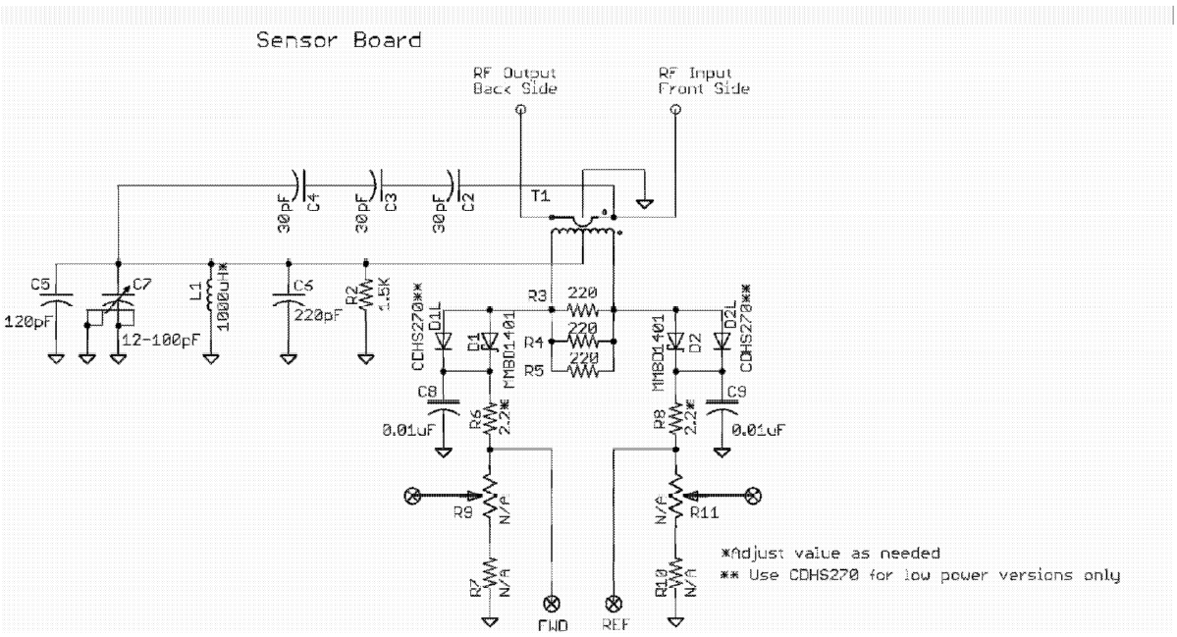
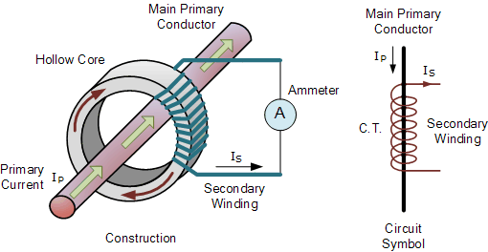
Standing Wave Ratio Sensor
A wide band current transformer will sense forward and reflected power on the feedline.
Center tap on the secondary winding allows measurement of forward vs reflected voltage.
FWD and REF voltage level sent to MCU for processing

Slide 9
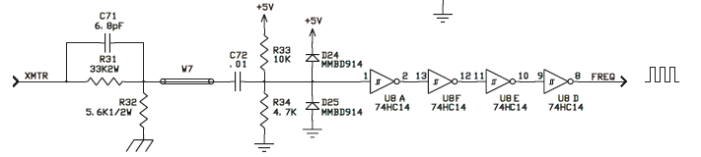
Frequency Counter
Schmitt Trigger will convert analog RF signal to square wave
Input conditioning for safe voltages

Slide 10
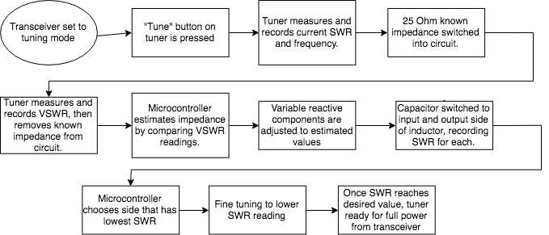
Algorithm

Slide 11
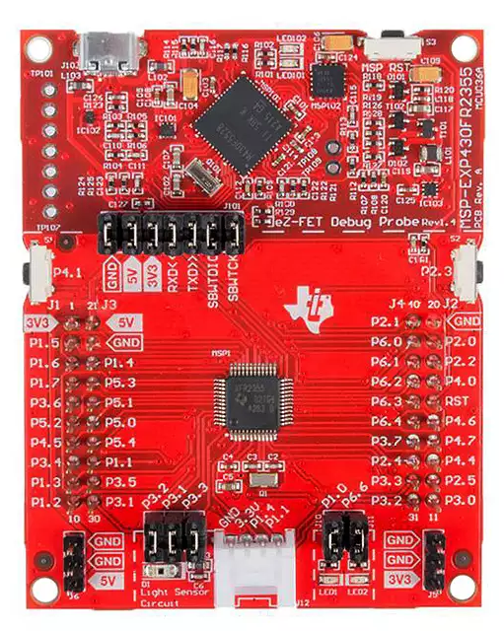
Microcontroller
Ti MSP430FR2355 Launchpad
→ 40 GPIO
→ 24MHz clock
→ 256kB FRAM
→ JTAG interface

Slide 12
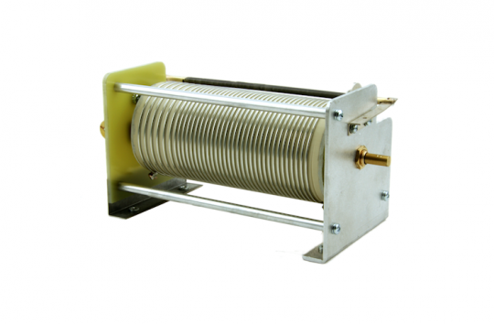
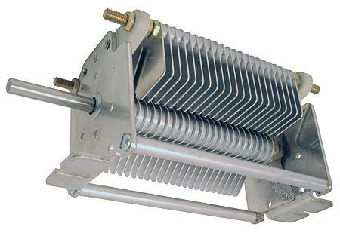
Variable Components
Variable Inductor
31 Revolution Cycle
Satisfies .3-30 MHz tuning range
Variable Capacitor
One revolution Cycle
500pf range
Notes:
The variable components are key to the tuning process of intellitune. They create the exact inductance and capacitance required for the impedance match. After the microcontroller calculates the estimated required additional impedance needed to make an impedance match. By using motors to turn each component, the value of capacitance or inductance changes! Gear on roller inductor with potentiometer to measure position , Potentiometer with smaller gear on capacitor shaft for potentiometer

Slide 13
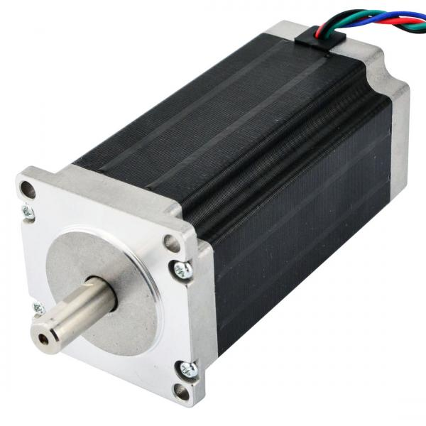
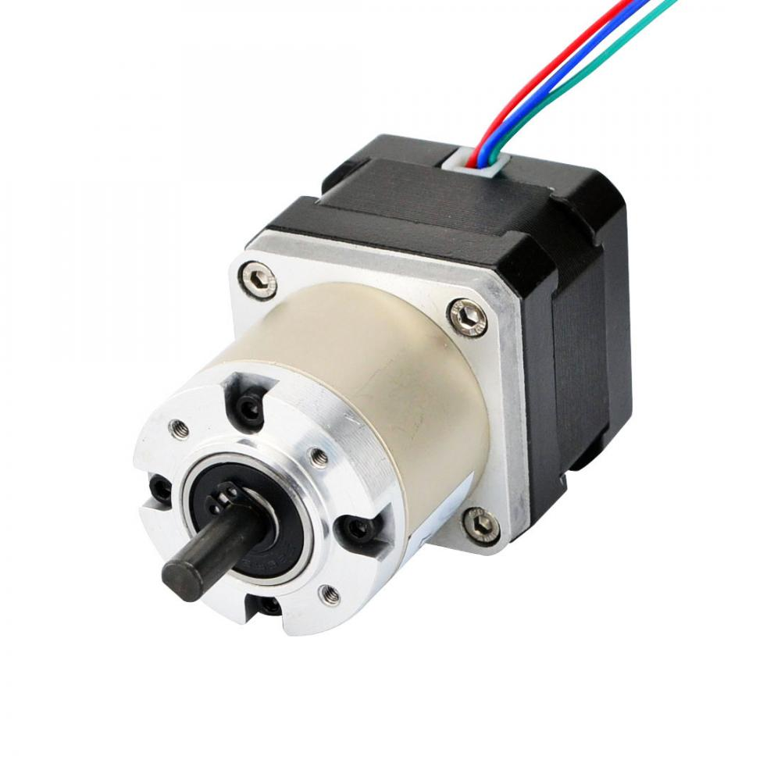
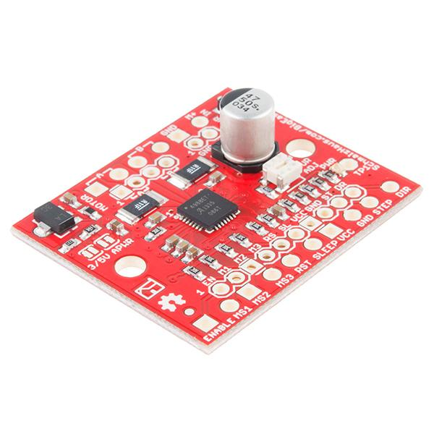
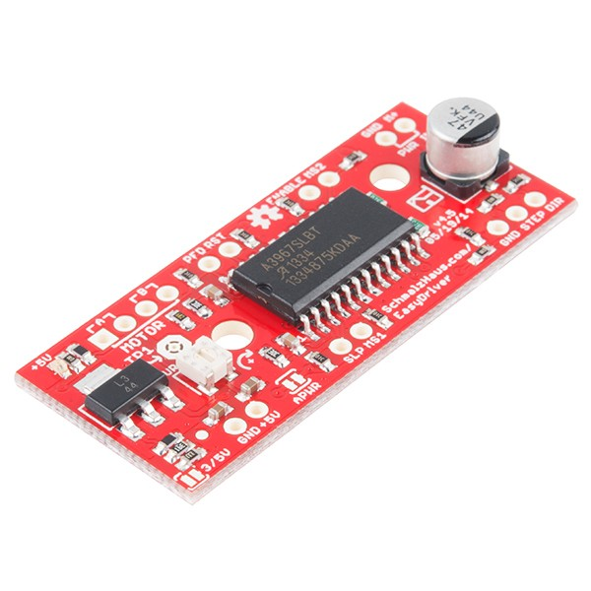
Motors/Driver
Big Easy Driver:
1 bipolar motor @
2A| >30 V
Easy Driver:
1 bipolar motor @
1A|6-30V
Nema 23 Bipolar motor
1.8 Step angle
1.7A|4.95V
6,200 Unique Values
Nema 17 geared Bipolar Motor
0.067 Step ange
0.4A|12V
5500 Unique Values
Notes:
Nema 23 will be used to drive our variable inductor as you can see it has a larger step angle than the Nema 17 geared. This will be beneficial for the inductor because you have to complete 31 revolutions. it operates at 1.7A|4.95V. On the other side is the Nema 17 geared. Internal gears allow the motor to acomplish a much smaller step angle. It will turn the variable capacitor. The capacitor only has one turn so you will get around 5500 unique values. this is comparable to the 6000 values you will achieve with the variable inductor. For the drivers we selected the Big easy driver for the nema 23 and the easy for the nema 17. As you can see they both will be able to drive their respective motors.

Slide 14
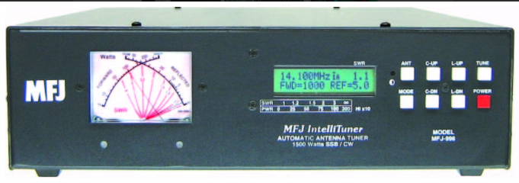
Enclosure + User interface
Notes:
We chose aluminum for our final enclosure. We started by looking at fiber glass, steel, and aluminum. Fiberglass was ruled out almost immediately. Aluminum has a couple advantages over steel for what we will be using it for. Aluminum is much easier to mold and shape as compared to steel which is not only harder to shape but also wears down machinery. Aluminum still gives us the advantage of being able to screw into to and be durable for the long term.

Slide 15
Timeline
August
September
October
November
Initial Research
Development
Integration
Debug
Learning the technology involved in the creation of Intellitune
Drawing the design of the subsystems and ordering components
Piecing together the subsystems and ensuring they are compatible
Finalize the product and eliminate all remaining issues

Slide 16

Progress
Subsystems identified
Schematic in the works
Parts ordered

Slide 17
References
[1] “More Links,” WW2 Navy Radio - The Radioman's Job. [Online]. Available: http://www.virhistory.com/ham/ . [Accessed: 04-Oct-2018].
[2] “Nema 23 Bipolar 1.8 degree 2.4Nm(340 oz.in) 1.8A 4.95V 57x57x104mm 4 wires”, stepperonline.com, 2018. [Online] Available: https://www.omc-stepperonline.com/hybrid-stepper-motor/nema-23-bipolar-18deg-24nm-340ozin-18a-495v-57x57x104mm-4-wires-23hs41-1804s.html?mfp=149-step-angle%5B1.8%5D%2C145-holding-torque-ncm%5B190%2C220%2C240%2C250%2C280%2C283%2C300%2C310%2C340%2C400%2C450%2C707%2C850%2C1300%2C2200%2C3000%5D.
[3] “Nema 17 Stepper Motor Bipolar L=33mm w/ Gear Ratio 27:1 Planetary Gearbox”, stepperonline.com, 2018. [Online] Available: https://www.omc-stepperonline.com/nema-17-stepper-motor-bipolar-l33mm-w-gear-raio-271-planetary-gearbox-17hs13-0404s-pg27.html.
[4] “Frequences supported”, www.denkikogyo.co.jp, 2018. [Online] Available: https://www.denkikogyo.co.jp/en/business/elec/frequency/index.html.
[5] “N4ZOU's Variable Inductor Design”, eHam.net, 2018. [Online] Available:https://www.eham.net/articles/9641.
[6] “Smith Chart Interface”, www.w7ay.net, 2018. [Online] Available: https://www.w7ay.net/site/Applications/AAplot/Contents/SmithChart.html.

Slide 18
References
[7] MFJ Enterprises Inc., Starkville, MS, USA, “Tuners, Antenna Tuners,” Available: http://www.mfjenterprises.com/Categories.php?sub=0&ref=5 . [Accessed: 30-Sep-2018].
[8] “Dr. Mehmet Kurum”, www.ecemsstate.edu, 2018. [Online] Available: http://www.ece.msstate.edu/people/faculty/dr-mehmet-kurum/.

Slide 19
Intellitune
Automatic ham radio antenna tuner

